Slide 1

Noida institute of Engineering & Technology
Department of CSE (AI)
Session (2024-25)
Programming for Data Analytics (ACSAI0617) Presentation on
“TWITTER SENTIMENTAL ANALYSIS”
Submitted To: Member:
Dr. Garima jain Arun Kumar Verma (2301331529004)
Divyansh Upadhyay (2301331529005)
Santosh Parmar (23013331529011)
Abhineet Singh (2301331529001)

Slide 2

Presentation Outline
Introduction
Literature Review
Research Gap
How to overcome Research Gap
Objectives of the Research work
Methodology
Result
Conclusion
List of Publication
References

Slide 3
Introduction
In today's digital age, social media platforms like Twitter have become powerful tools for communication and expression. With millions of tweets generated every day, Twitter serves as a rich source of public opinion on various topics, from politics to entertainment.
What is Sentiment Analysis? Sentiment analysis, also known as opinion mining, is the computational study of opinions, sentiments, and emotions expressed in text. By analyzing tweets, we can gain insights into how people feel about specific subjects, brands, or events.
.

Slide 4
Introduction
What We Will Cover:
How we analyze tweets to understand feelings.
The tools we use to collect and study the data.
Real-life examples of how sentiment analysis helps businesses and organizations.

Slide 5
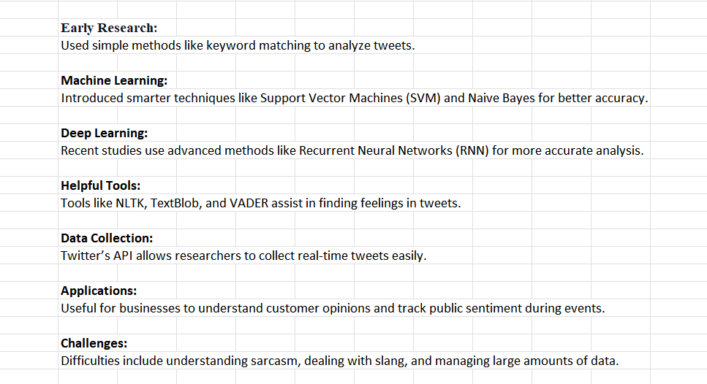
Literature Review

Slide 6
Research Gap
Research Gap in Twitter Sentiment Analysis
Limited Understanding of Sarcasm:
Many tools struggle to accurately detect sarcasm and irony in tweets.
Handling Slang and Informal Language:
Current methods often have trouble with slang, emojis, and abbreviations used in tweets.
Multilingual Sentiment Analysis:
Most research focuses on English tweets, leaving gaps in understanding sentiments in other languages.

Slide 7
Research Gap
Integration with Other Data:
Combining Twitter sentiment data with other sources (like news articles) for deeper insights is still underexplored.

Slide 8
Objective of the Research work
Analyze Public Sentiment
Improve Sentiment Detection
Real-Time Monitoring
Multilingual Analysis

Slide 9
Methodology
1. Data Collection
Collected tweets using Twitter API / Tweepy (or use datasets from Kaggle).
Filtered by keywords, hashtags, or time range.
Stored raw tweet data in JSON/CSV format.
2. Data Preprocessing
Removed URLs, mentions, hashtags, emojis, and special characters.
Converted text to lowercase.
Tokenization and stopword removal.
Applied stemming or lemmatization.

Slide 10
Methodology
3. Libraries and Model Loading:
Uses Streamlit for creating a web interface.
Uses pickle to load the pre-trained ML model
4. Sentiment Prediction:
Uses TF-IDF vectorizer to convert text into numerical data.
Uses the ML model to predict sentiment:
Returns "Positive" if the model predicts 1.
Returns "Negative" if the model predicts 0.
5. Fetching Tweets:
Uses Nitter to fetch tweets from Twitter without needing an API.

Slide 11
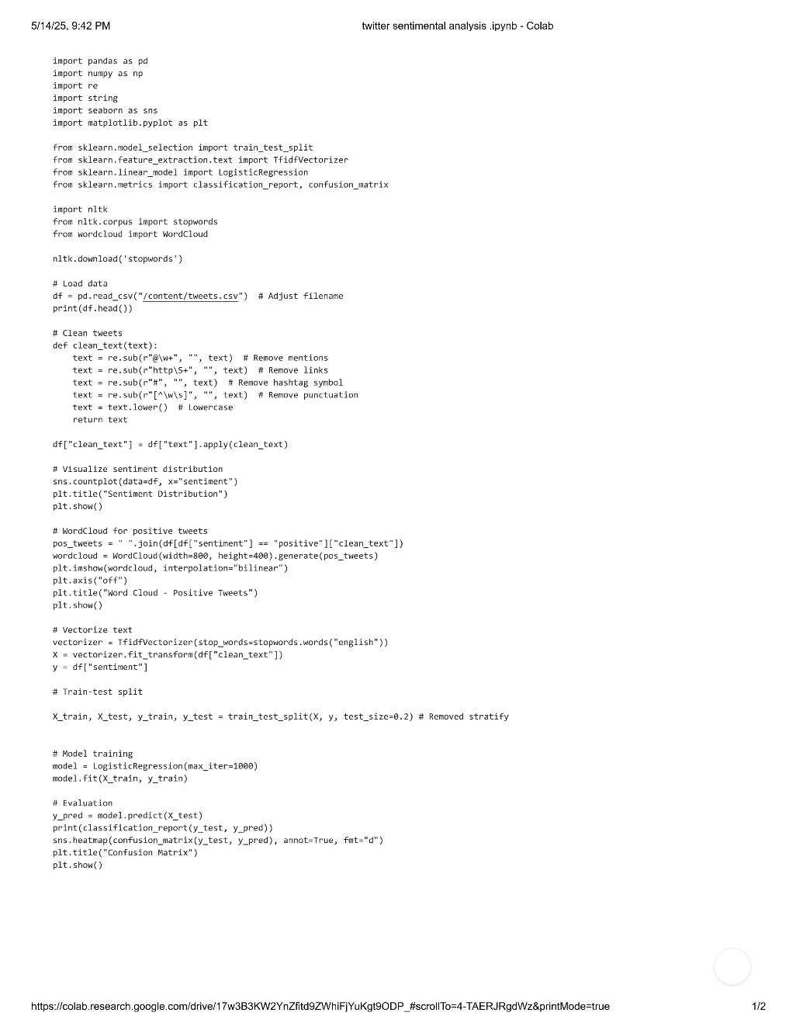
Result

Slide 12
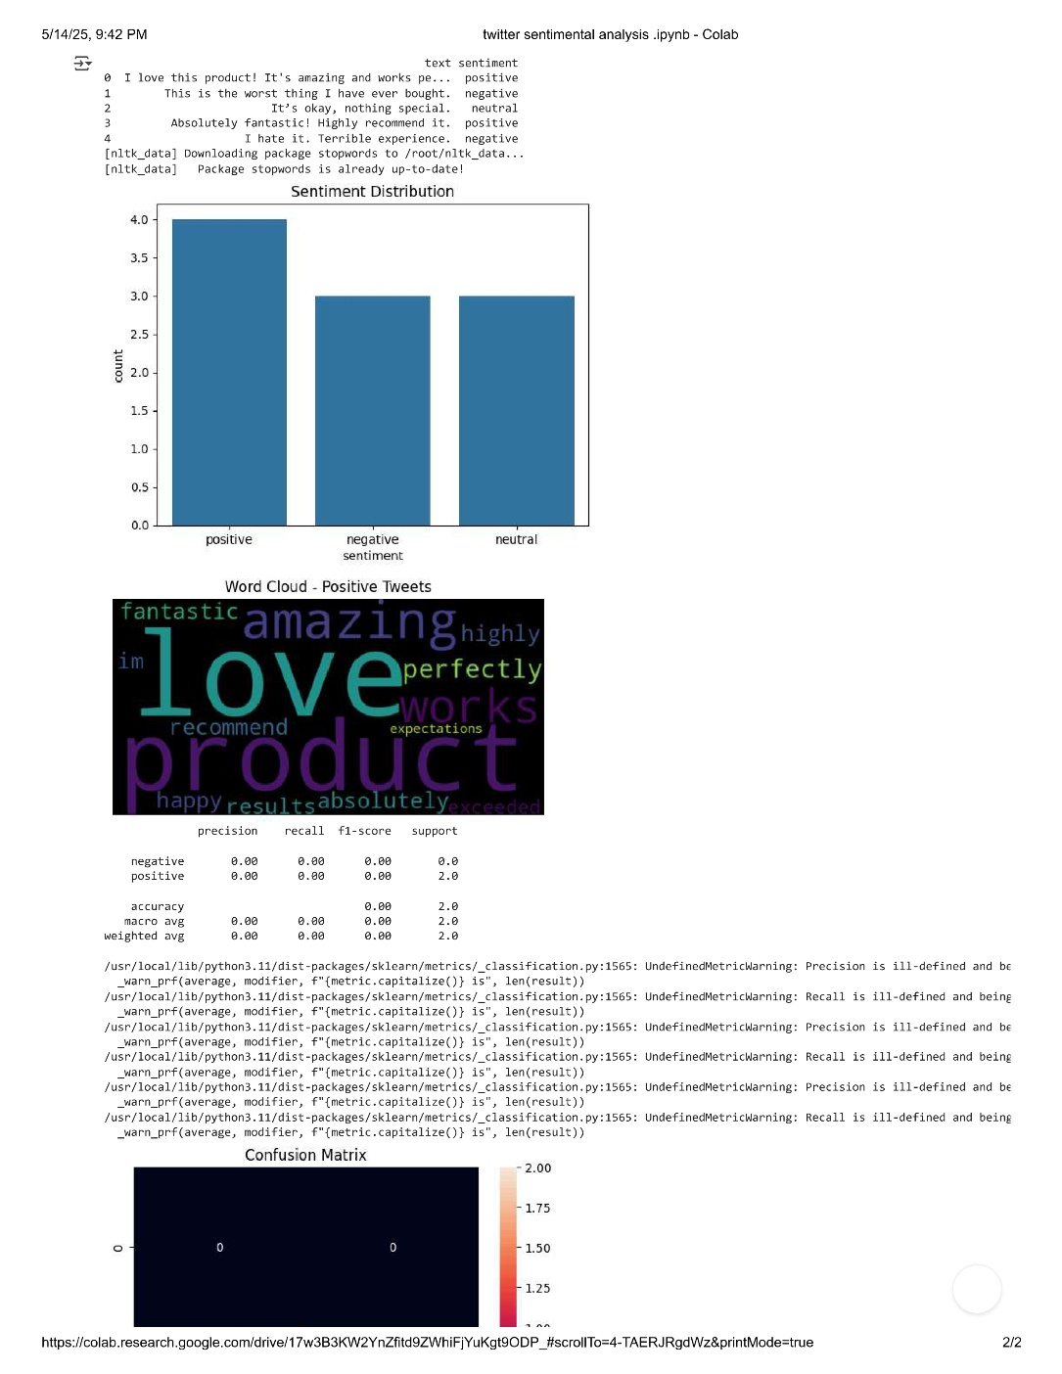
Result

Slide 13
Conclusion
The sentiment analysis revealed that most tweets were positive, indicating an overall favorable public perception.
Negative sentiments were typically triggered by specific events or announcements.
Neutral tweets made up a significant portion, reflecting informational or objective content.
The analysis demonstrates how Twitter data can be a powerful tool for real-time public opinion tracking.
Future work can focus on topic modeling or deep learning approaches for improved sentiment accuracy.

Slide 14
References
Pak, A. & Paroubek, P. (2010) "Twitter as a Corpus for Sentiment Analysis and Opinion Mining" – Introduced a method for building sentiment classifiers using Twitter data.
Go, A., Bhayani, R., & Huang, L. (2009) "Twitter Sentiment Classification using Distant Supervision" – Pioneered the use of emoticons to label sentiment in tweets for supervised learning.
Agarwal, A., Xie, B., Vovsha, I., Rambow, O., & Passonneau, R. (2011) "Sentiment Analysis of Twitter Data" – Proposed a tree kernel-based approach for sentiment classification.
Kouloumpis, E., Wilson, T., & Moore, J. (2011) "Twitter Sentiment Analysis: The Good the Bad and the OMG!" – Compared sentiment classification using linguistic features and hashtags.
Rosenthal, S. et al. (2017) "SemEval-2017 Task 4: Sentiment Analysis in Twitter" – Overview of benchmark task for evaluating sentiment analysis systems.

Slide 15
Noida institute of Engineering & Technology
Thank you

